Slide 1

Recent Trade and Investment Trends

Slide 2
Lecture Outcome
To understand the recent world trade and foreign Investment trends
To understand India's Export and Import trading partners

Slide 3
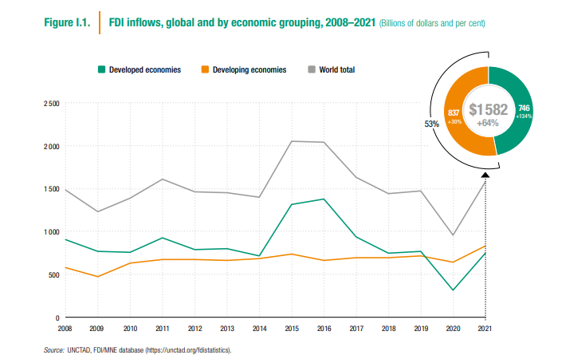
Global FDI flows in 2021 were $1.6 trillion up by 64 percent than in 2020

Slide 4
Global FDI flows in 2021 were $1.6 trillion up by 64 percent than in 2020
Global foreign direct investment (FDI) flows in 2021 were $1.58 trillion, up 64 per cent from the level during the first year of the COVID-19 pandemic of less than $1 trillion.
However, the global environment for international business and cross-border investment changed dramatically in 2022 with the onset of the war in Ukraine, which occurred while the world was still reeling from the impact of the pandemic.
Investor uncertainty and risk aversity could put significant downward pressure on global FDI in 2022.
Russian Federation and Ukraine, and its ripple effects through sanctions, supply shortages in energy and basic commodities, and broader macroeconomic impact, is not the only factor cooling FDI prospects for 2022

Slide 5
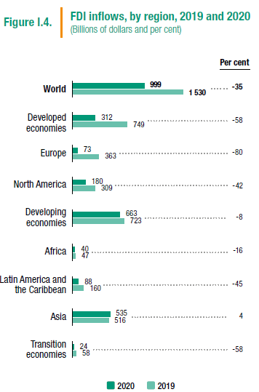
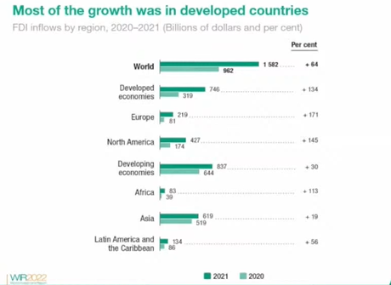

Slide 6
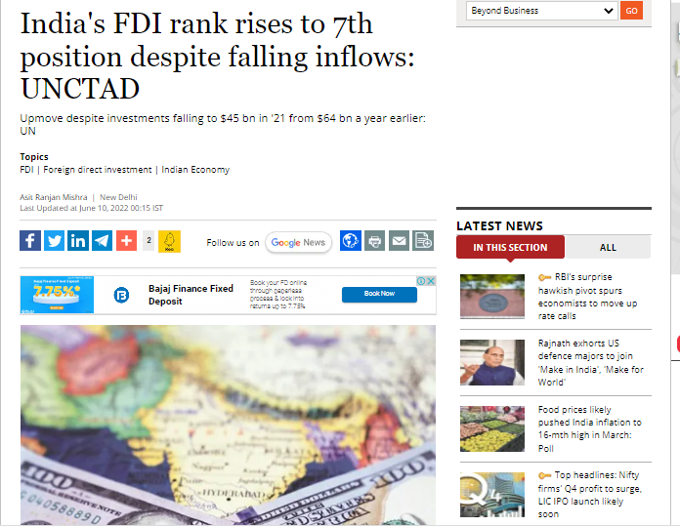
United Nations Conference on Trade and Development
https://www.business-standard.com/article/economy-policy/india-s-fdi-rank-rises-to-7th-position-despite-falling-inflows-unctad-122060900883_1.html
Notes:
https://www.business-standard.com/article/economy-policy/india-s-fdi-rank-rises-to-7th-position-despite-falling-inflows-unctad-122060900883_1.html

Slide 7
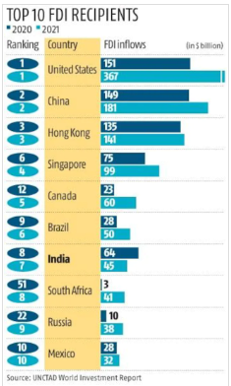

Slide 8
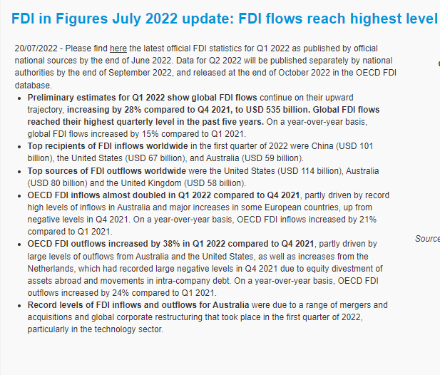
Notes:
https://www.oecd.org/investment/statistics.htm

Slide 9
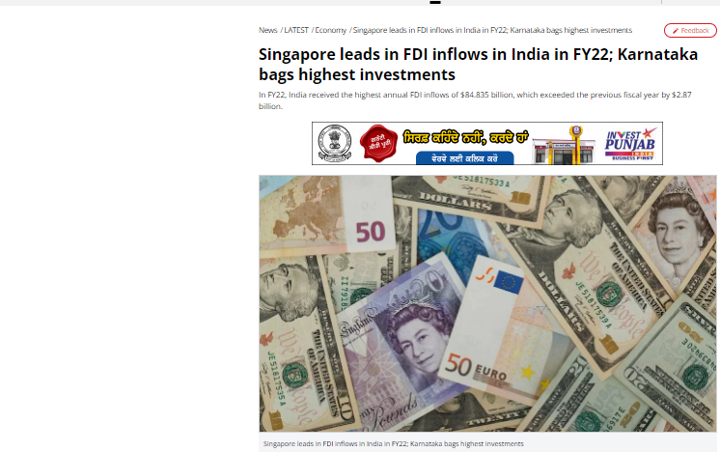
Notes:
https://www.businesstoday.in/latest/economy/story/singapore-leads-in-fdi-inflows-in-india-in-fy22-karnataka-bags-highest-investments-342998-2022-07-28

Slide 10
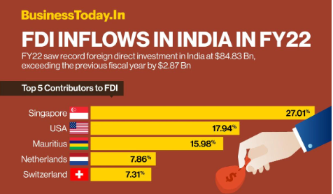

Slide 11
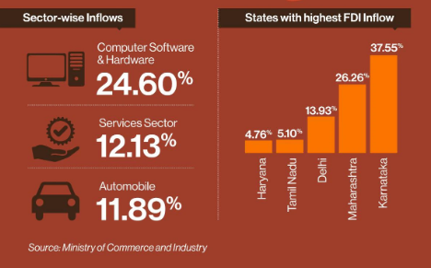

Slide 12
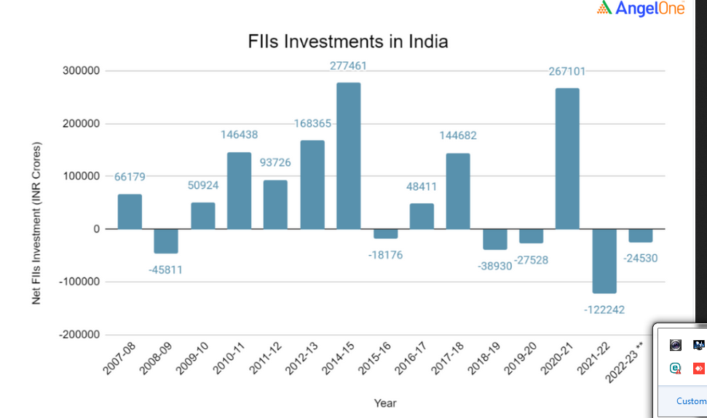

Slide 13
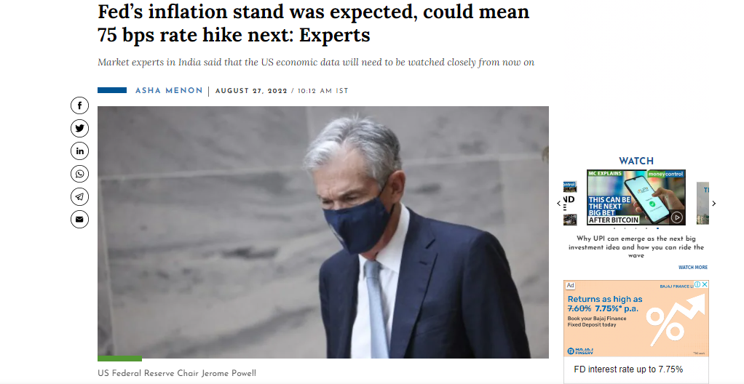
Notes:
https://www.moneycontrol.com/news/business/markets/feds-inflation-stand-was-expected-could-mean-75-bps-rate-hike-next-experts-9093561.html

Slide 14
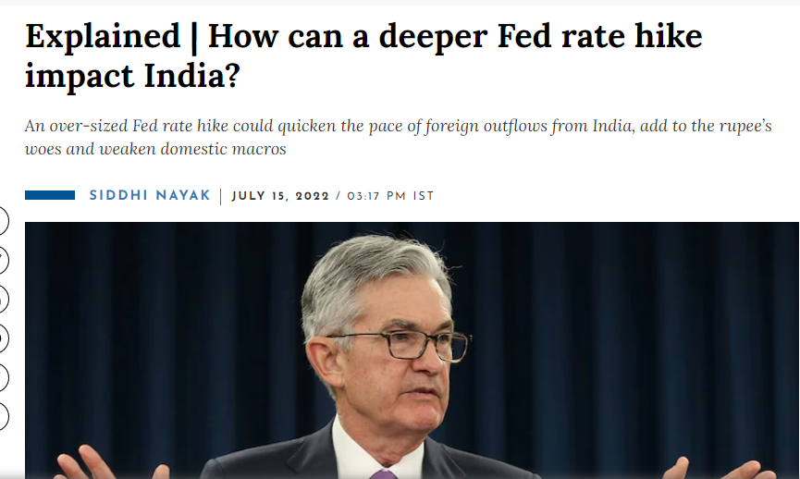
Notes:
https://www.moneycontrol.com/news/business/explained-how-can-a-deeper-fed-rate-hike-impact-india-8834011.html

Slide 15
FII SEBI Data
https://www.sebi.gov.in/statistics/fpi-investment/fpi-calendar-year/fpi-investment-details-financial-year.html
FIIs Flows - daily data
https://www.moneycontrol.com/stocks/marketstats/fii_dii_activity/index.php

Slide 16
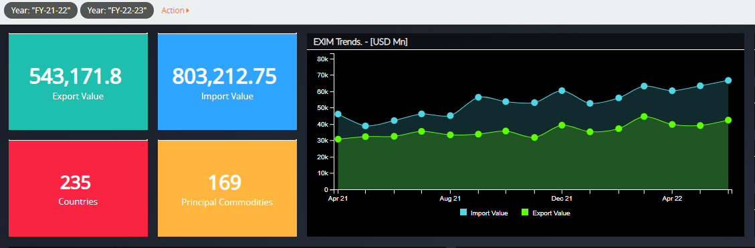
India EXIM Overview 2021-2022
Notes:
http://www.eximanalytics.dgciskol.gov.in/dgcis/EXIM-Analytics#/dashboard/EXIM-Overview?_g=()&_a=(action:1,filters:!((meta:(bcolor:'rgba(40,%2040,%2040,%200.78)',colName:'',disabled:!f,index:brc_data_new,isAll:!f,key:Year,negate:!f,selAll:!f,value:%22FY-21-22%22),query:(term:(Year:FY-21-22))),(meta:(bcolor:'rgba(40,%2040,%2040,%200.78)',colName:'',disabled:!f,index:brc_data_new,isAll:!f,key:Year,negate:!f,selAll:!f,value:%22FY-22-23%22),query:(term:(Year:FY-22-23)))),mainId:EXIM-Overview,panels:!((col:1,id:E1a-%255BINR-Th.-Cr.%255D%3Fop_type%3Dcreate,row:1,size_x:2,size_y:2,type:visualization),(col:5,id:EXIM-Trends.-%255BINR-Th.-Cr.%255D%3Fop_type%3Dcreate,row:1,size_x:6,size_y:4,type:visualization),(col:7,id:Top-Principal-Commodities-Imported.-%255BINR-Th.-Cr.%255D%3Fop_type%3Dcreate,row:10,size_x:6,size_y:5,type:visualization),(col:3,id:E2b-%255BINR-Th.-Cr.%255D%3Fop_type%3Dcreate,row:1,size_x:2,size_y:2,type:visualization),(col:1,id:E4,row:3,size_x:2,size_y:2,type:visualization),(col:3,id:E5,row:3,size_x:2,size_y:2,type:visualization),(col:11,id:F1,row:2,size_x:2,size_y:1,type:visualization),(col:11,id:F2,row:3,size_x:2,size_y:1,type:visualization),(col:11,id:F3,row:4,size_x:2,size_y:1,type:visualization),(col:1,id:Top-Principal-Commodities-Exported.-%255BINR-Th.-Cr.%255D%3Fop_type%3Dcreate,row:5,size_x:6,size_y:5,type:visualization),(col:11,id:F4,row:1,size_x:2,size_y:1,type:visualization),(col:7,id:Countries-of-Exports-%255BINR-Th.-Cr.%255D%3Fop_type%3Dcreate,row:5,size_x:6,size_y:5,type:visualization),(col:1,id:Countries-of-Imports-%255BINR-Th.-Cr.%255D%3Fop_type%3Dcreate,row:10,size_x:6,size_y:5,type:visualization)),project:(),query:(query_string:(analyze_wildcard:!t,query:'*')),refProject:'',theme:black.jpg,title:'EXIM%20Overview',upref:0)

Slide 17
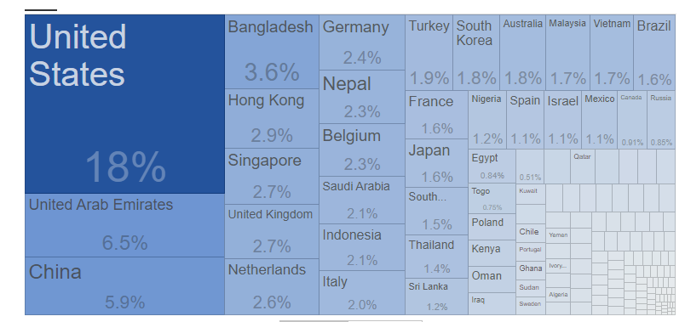
India Exports Country wise (FY2021)

Slide 18
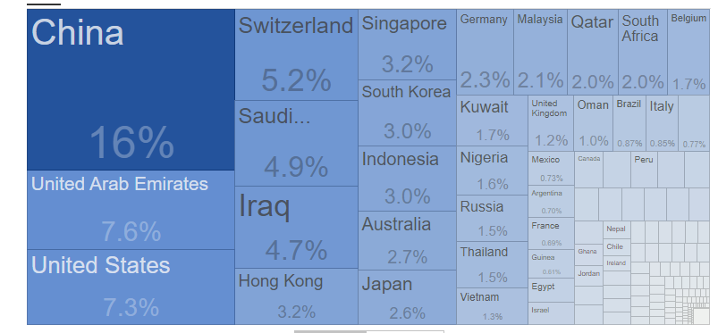
India Imports Country wise (FY2021)
Notes:
https://tradingeconomics.com/india/imports-by-country

Slide 19
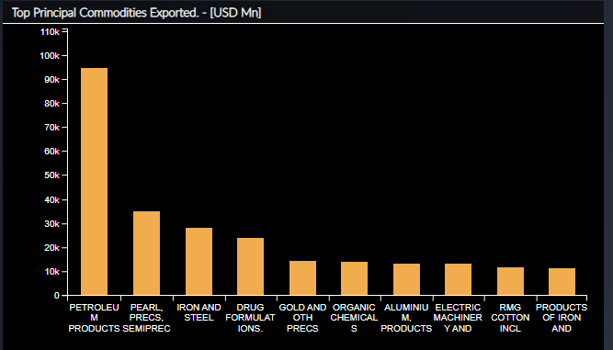
TOP PRINCIPAL COMMODITIES EXPORTED FROM INDIA

Slide 20
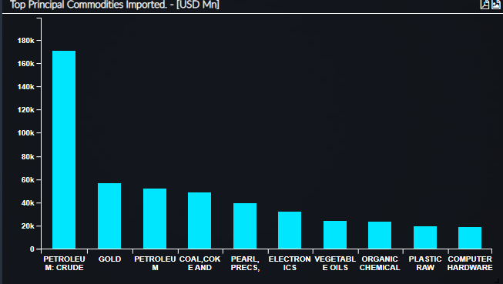
TOP PRINCIPAL COMMODITIES IMPORTED BY INDIA

Slide 21
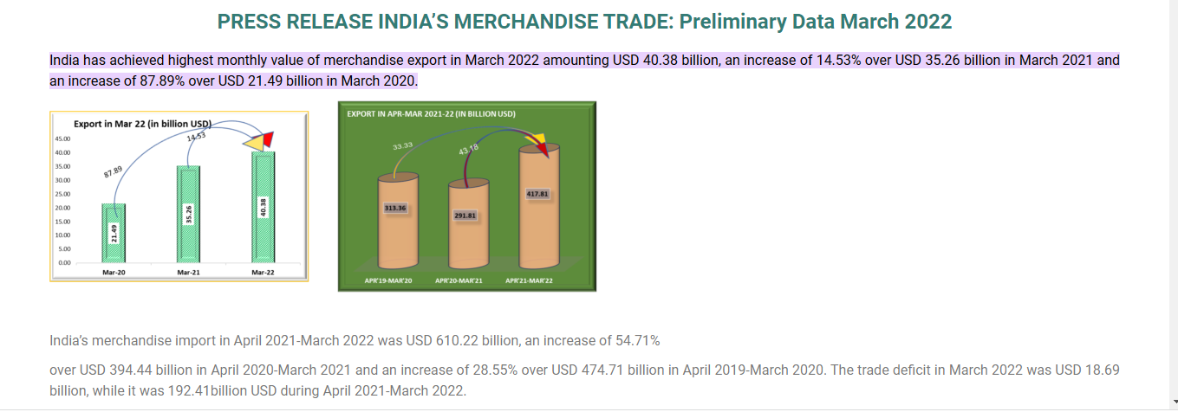
Notes:
https://commerce.gov.in/press-releases/press-release-indias-merchandise-trade-preliminary-data-march-2022/#:~:text=Ministry%20of%20Commerce%20and%20Industry,-DEPARTMENT%20OF%20COMMERCE&text=India%20has%20achieved%20highest%20monthly,21.49%20billion%20in%20March%202020.

